Slide 1
Secure Instant Messaging
GR 8
Chenguang Zhang
Ziqi Chen
Lingqi Meng

Slide 2
Context
Motive
Our Work
Implementation Details
References

Slide 3
Motive
Instant Message
Email
Security Challenges
Replay
Eavesdropping
Replay
…

Slide 4
Our work
1
A secure instant messaging system
2
Functionality: logging in, online list, secure text messaging, etc.
3
Security Services: confidentiality, peer-entity and message authentication, integrity, nonrepudiation

Slide 5
Client-Server Architecture with Kerberos Authentication
Kerberos
Messages are transmitted through server to guarantee central control of data.
Client1
Client2
Client3
···
ClientN
Server

Slide 6
Phase I : Authentication —— Kerberos
Authentication server (AS)
Database
(1) requests TGS-ticket
Client
(2) sends TGS-ticket + session key
Authentication server (AS)
(3) requests service granting ticket
(4) sends service granting ticket + session key
(5) requests service
(6) provides server authenticator
Server
Result: Shared session key between client and server

Slide 7
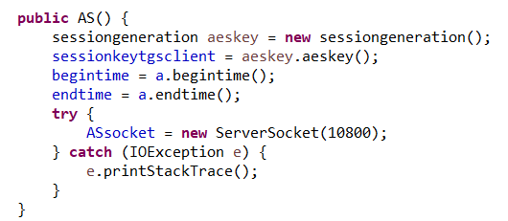
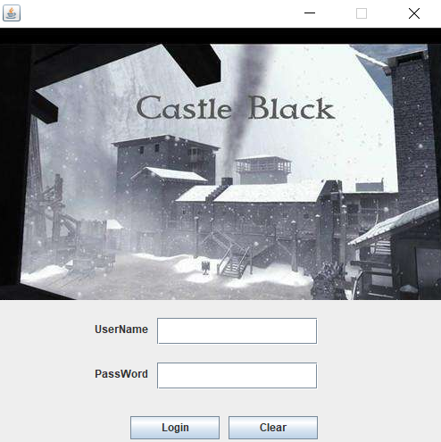
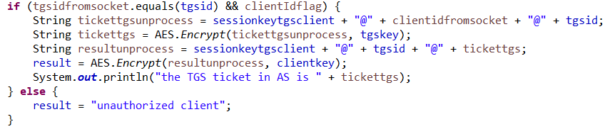
Phase I
Client
AS
AS listening at port 10800
04fc711301f3c784d66955d98d399afb@111111111@20171212200526
Client
AS
suTguRN2FjschXw=@111111111@
4f15e903add2d7b557613ea4258853b0255e3fe4442166b59d692cd8c969ca58fffaf45e56109b649a4cb2db78f13c9e35cd8b565ba93843520367282e30cbf4

Slide 8
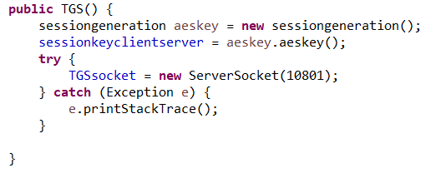
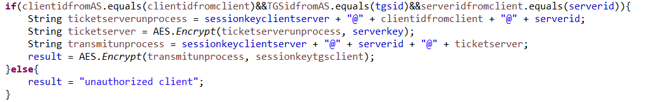
Request TGS
TGS listening at port 10801
Client
TGS
222222222@4f15e903add2d7b557613ea4258853b0255e3fe4442166b59d692cd8c969ca58fffaf45e56109b649a4cb2db78f13c9e35cd8b565ba93843520367282e30cbf4@2d6a80c862c1039de8bc9d21a2251b25
Client
TGS
ofBtvBWdGZ3LDio=@222222222@442956401baf0a28359cd224f54ccfbf395df880e32f65cc66610139d98b3ba4ed76e6e2f9c1003d26117d6d8d80ab04

Slide 9
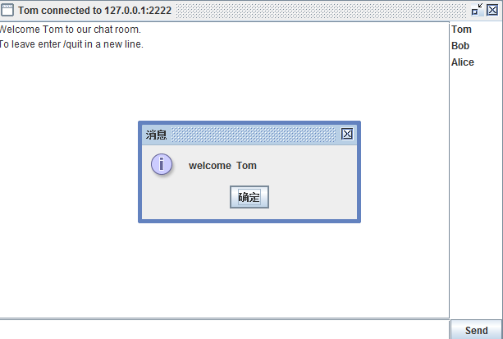
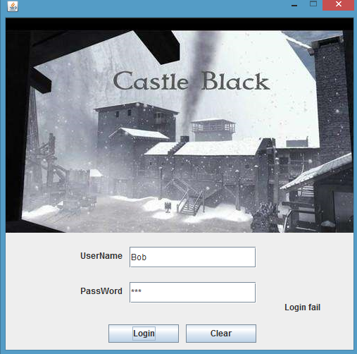
Connect to server
Client
Server
ticket@auth
442956401baf0a28359cd224f54ccfbf395df880e32f65cc66610139d98b3ba4ed76e6e2f9c1003d26117d6d8d80ab04@2d6a80c862c1039de8bc9d21a2251b25
Client
timestamp
Server
b268111a1416801f110fd739e11fa690

Slide 10
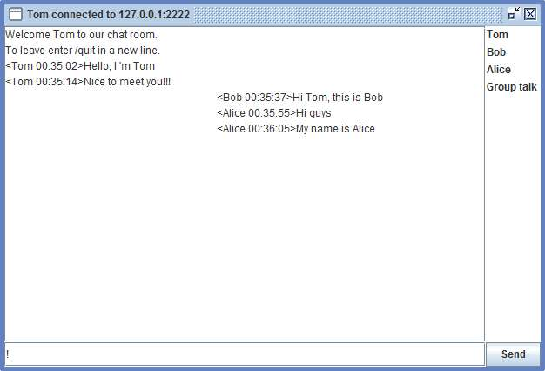
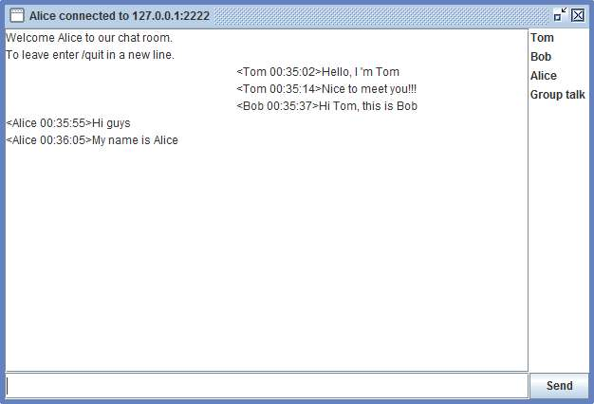
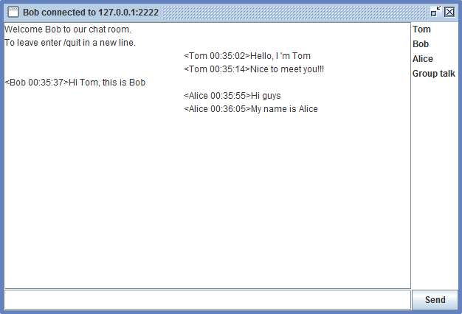
Group Chat (default)
Online
list
Sender’s name
sent
received

Slide 11
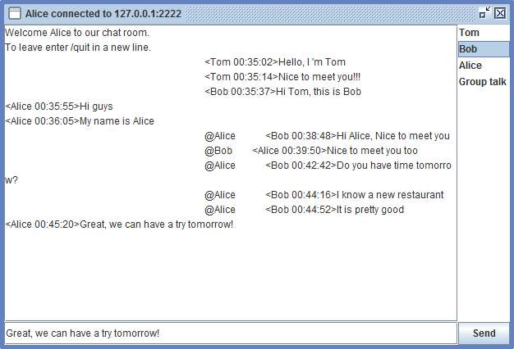
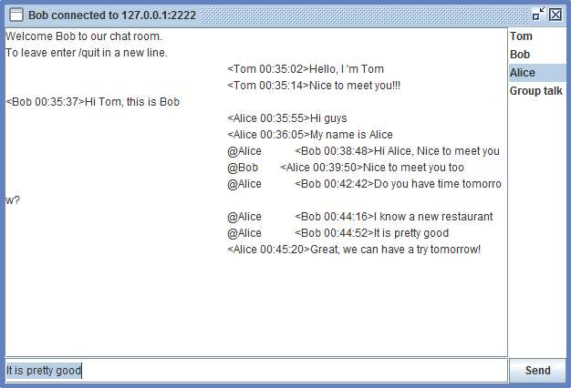
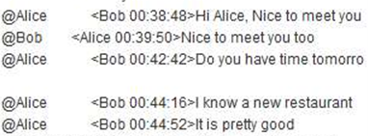
Private Chat
Tom cannot receive the private message between Alice and Bob
Private message
to Alice
Message aim

Slide 12
Phase II : Client Key Exchange —— Diffie-Hellman Algorithm
①
②
③
③
Result: Exchange secret key K between Client1 and Client2

Slide 13
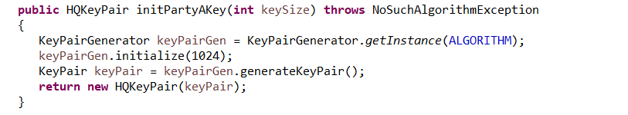
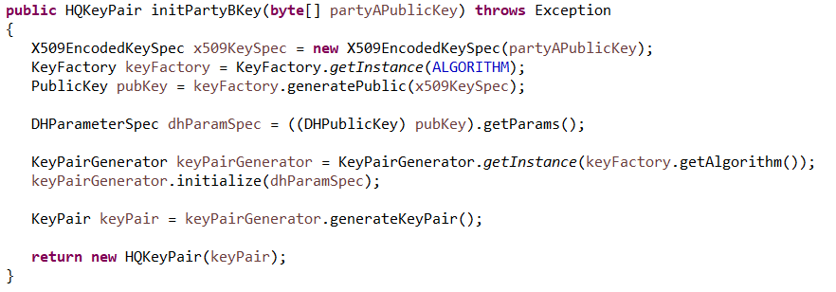
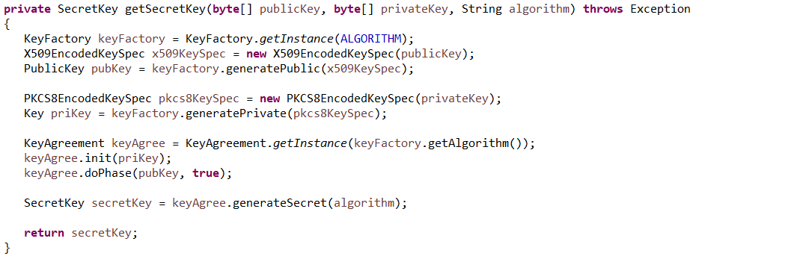
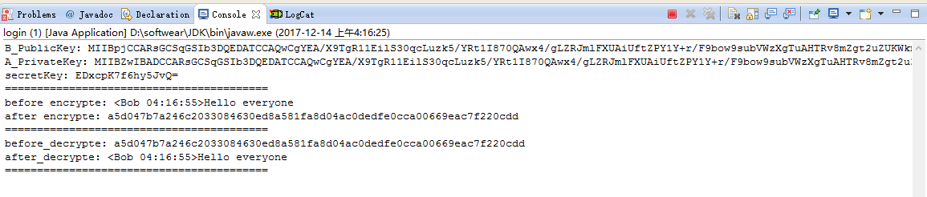
Phase II : Client Key Exchange —— Diffie-Hellman Algorithm
①
②
③
Console print from client

Slide 14
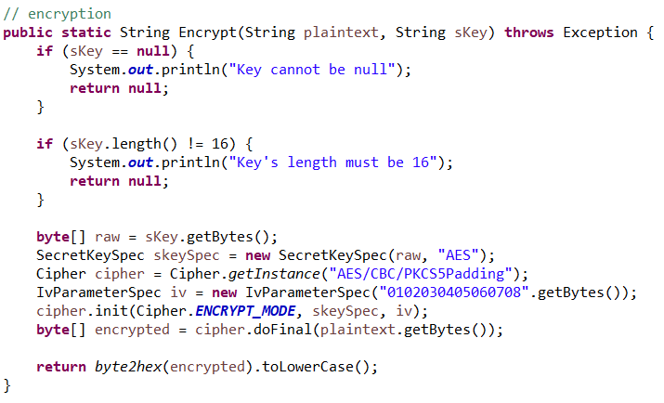
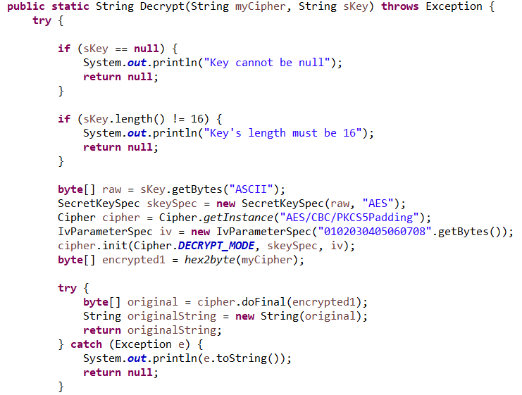
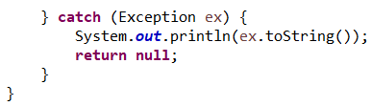
Phase III : Encrypted Communication —— AES
Krberos

Slide 15
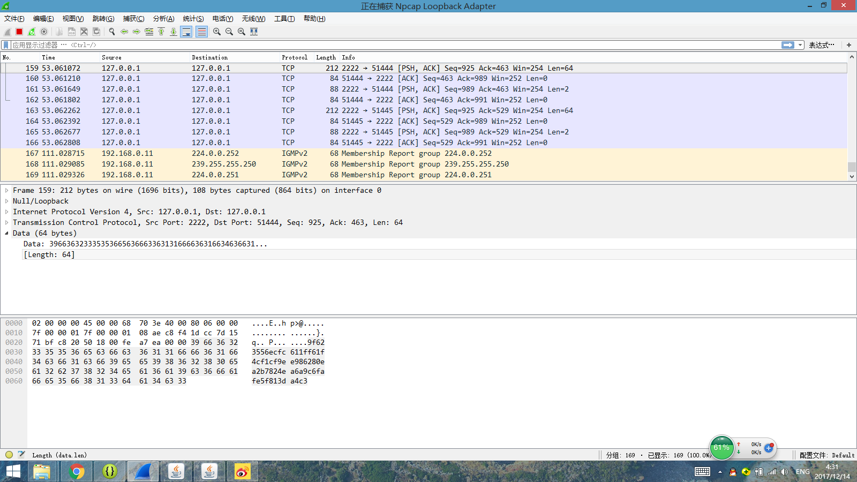
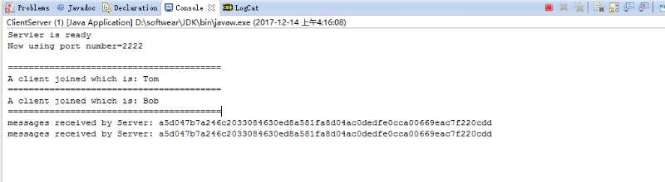
Bad Test --Sniffing
Console print from server
Krberos
All messages has been encrypted, so even if attackers sniff the message, it is meaningless

Slide 16
Reference
Hiroaki Kikuchi, Minako Tada. (2004) Secure Instant Messaging Protocol Preserving Confidentiality against Administrator
William Stallings. (2011) Network Security Essentials: Applications and Standards, Fourth Edition.
Jimmy Florez Z, Camilo Logreira R. (2016) Architecture of Instant Messaging Systems for Secure Data Transmission
Changji Wang, Welong Lin (2013) Design of An Instant Messaging System Using Identity Based Cryptosystems.
B.Clifford Neuman, Theodore Ts’o. (1994) Kerberos: An Authentication Service for Computer Networks.
Anita Narwal, Sunita Tomar. (2015) Kerberos Protocol: A Review
Michael Steiner, Gene Tsudik. (1996) Diffie-Hellman Key Distribution Extended to Group Communication.

Slide 17
Thank you
Chenguang Zhang
Ziqi Chen
Lingqi Meng

